Slide 1

FlexRay Communication Protocol
Younsuk Choi
Thanas Dushku
Neaz Mahmud

Slide 2
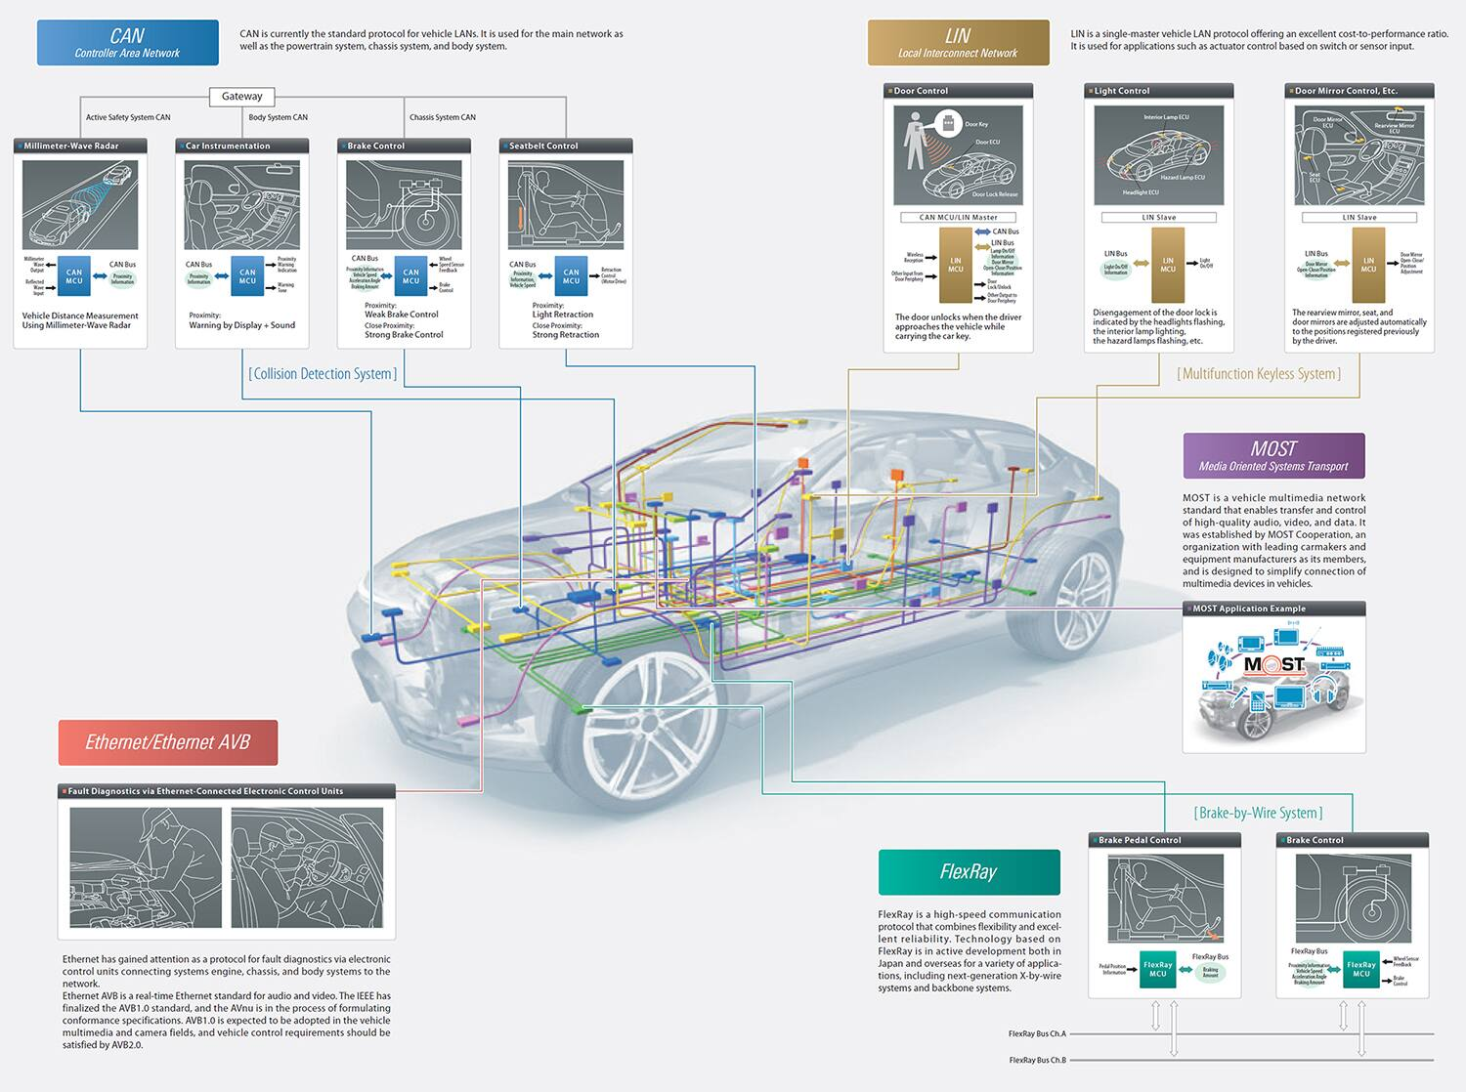
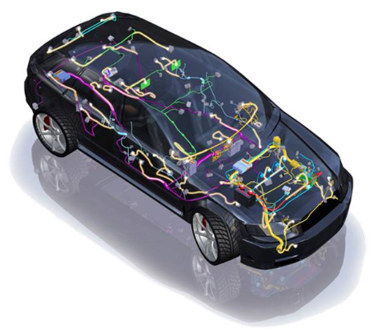
Introduction
Features of Modern Automotive
E/E Architectures
Complex Distributed Systems
ECU : Electronic Control Units
Communication Protocols

Slide 3
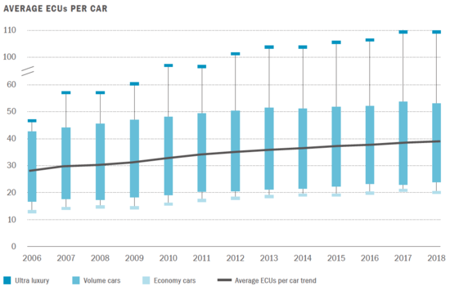
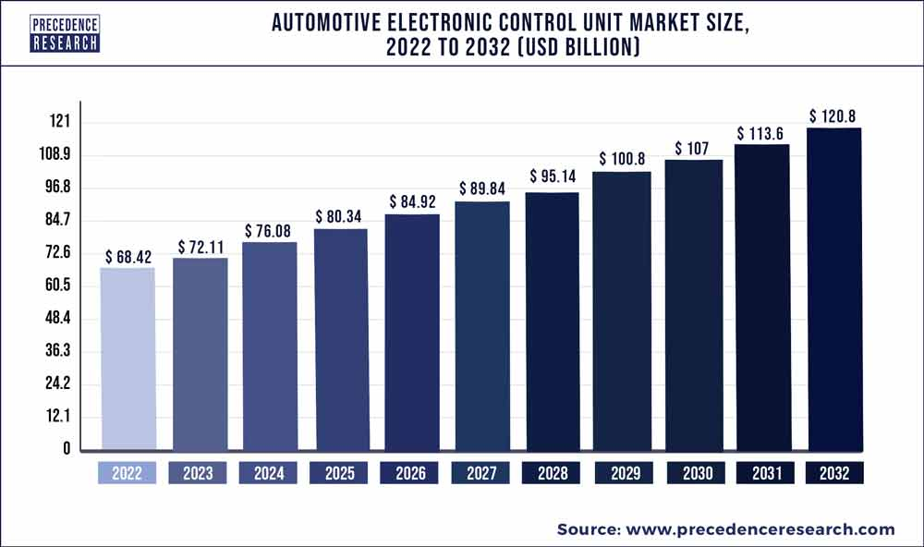
Introduction

Slide 4
Genesis of Flexray
In 2000, several leading automotive companies, including BMW, DaimlerChrysler (now Daimler AG), and General Motors, recognized the need for a new communication protocol.
In 2004, the FlexRay Consortium introduced the FlexRay specification, which outlined the technical details and features of the protocol. (The specification provided guidelines for the physical layer, communication protocol, network management, and application interface.)
Following the release of the FlexRay specification, the automotive industry started to adopt the protocol.
Over the years, the FlexRay Consortium continued to enhance the protocol and address emerging requirements.
In 2011, the International Organization for Standardization (ISO) adopted FlexRay as an international standard (ISO 17458), providing further recognition and standardization for the protocol.

Slide 5
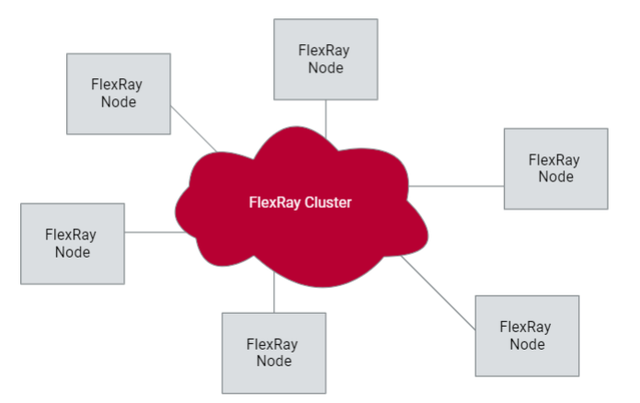
Flexray Architecture
Nodes:
Sensor nodes
Electronic control units
Time triggered
Specific interval data
Event triggered:
Occurrences
Flexray Cluster

Slide 6
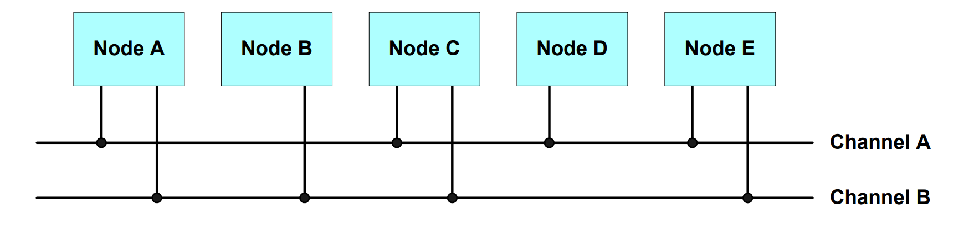
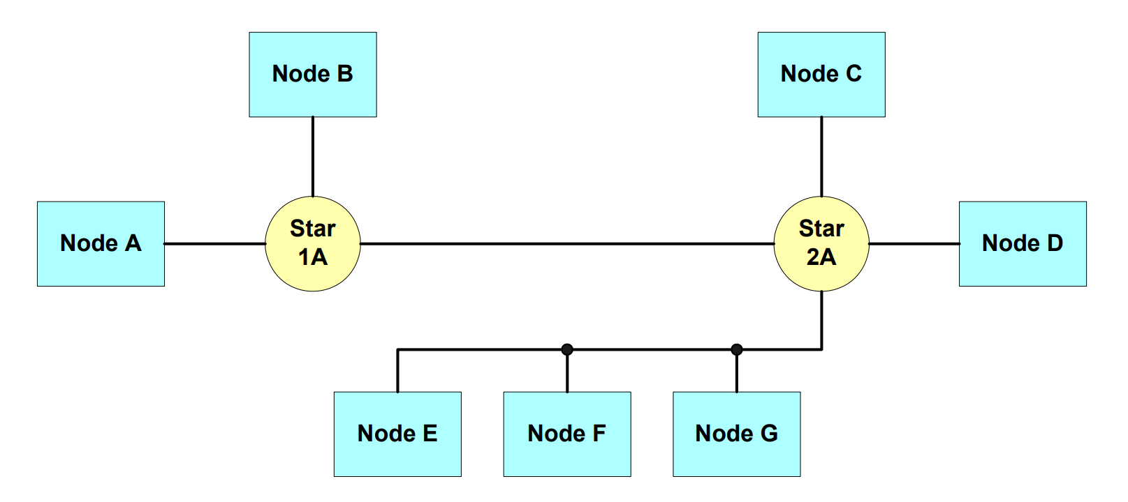
Network Topology
Point to point
Passive bus:
1- Single channel
2- Dual channel : Redundancy or bitrate
Active star
Hybrid toplogy

Slide 7
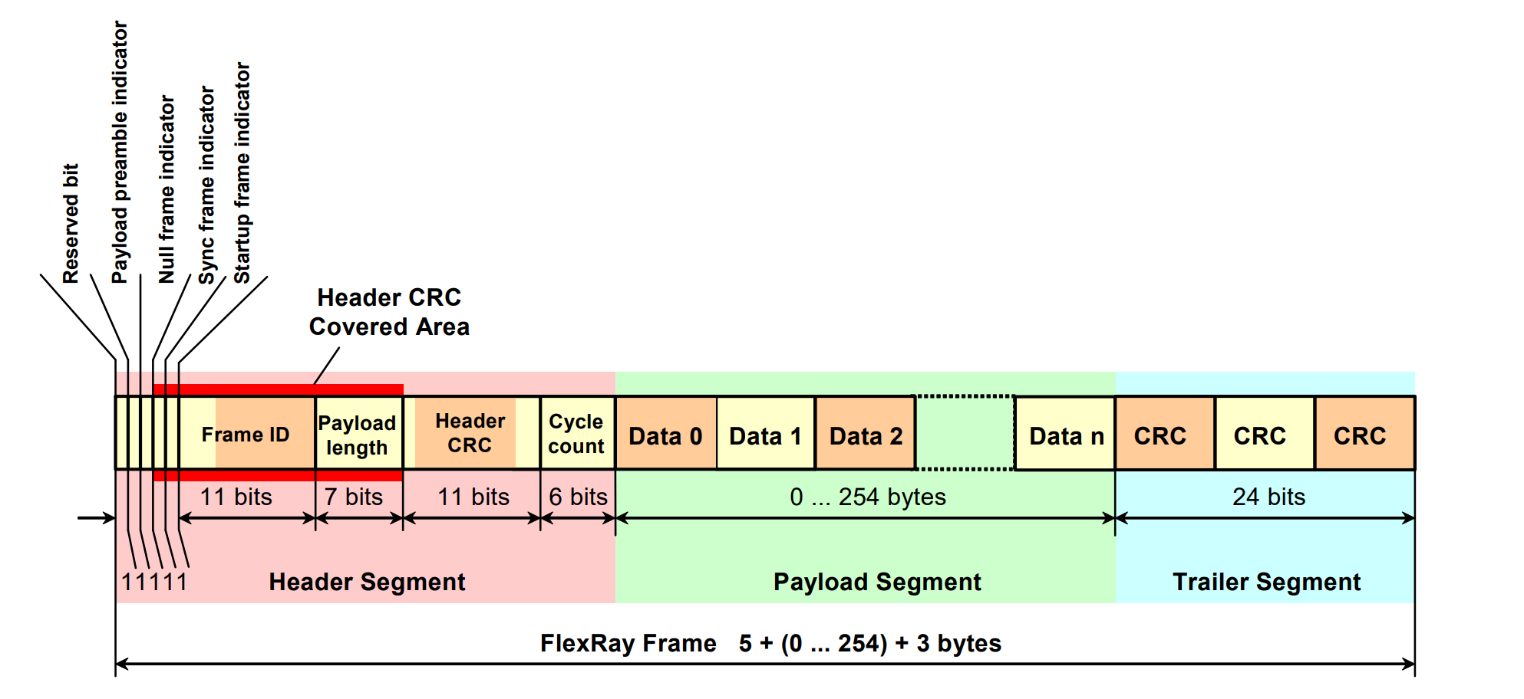
Frame format and scheduling
Variety of data types
Static or dynamic
Static scheduled signals require transmition within fixed intervals
Clocks and synchronizing
Drifting
Sync time frame segments
Approximate global time
FAULT TOLERANT!

Slide 8
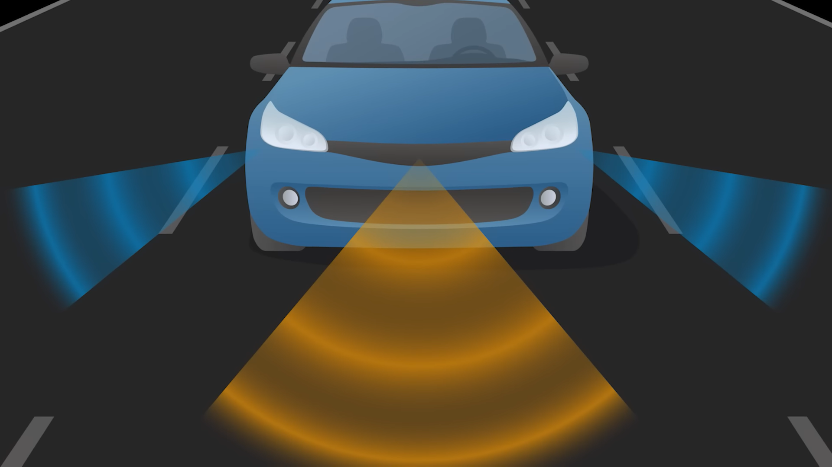
Adaptive Cruise Control

Slide 9
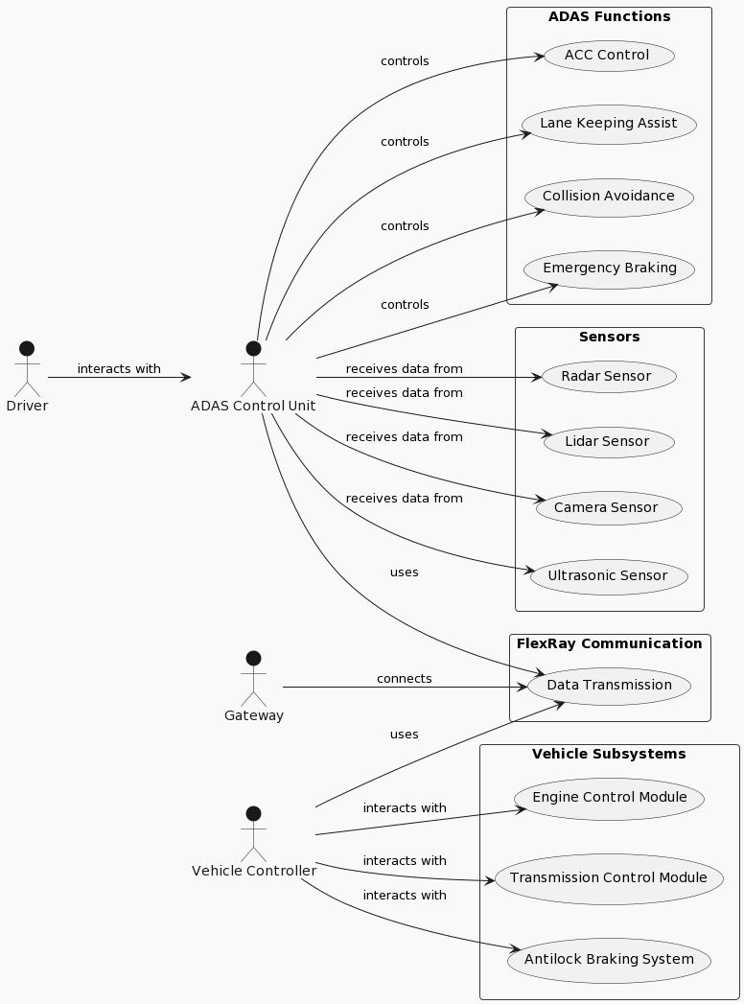
Use Case

Slide 10
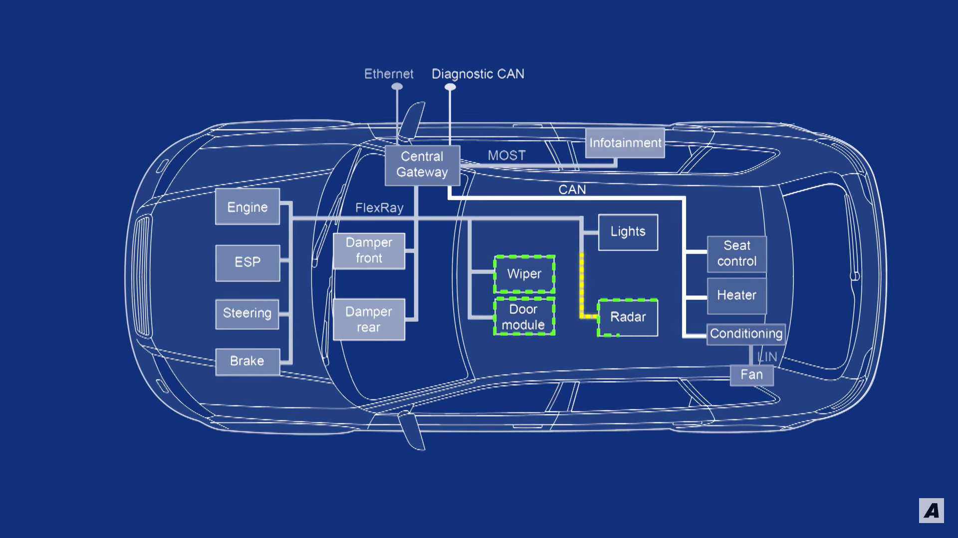
FlexRay In Adaptive Cruise Control

Slide 11
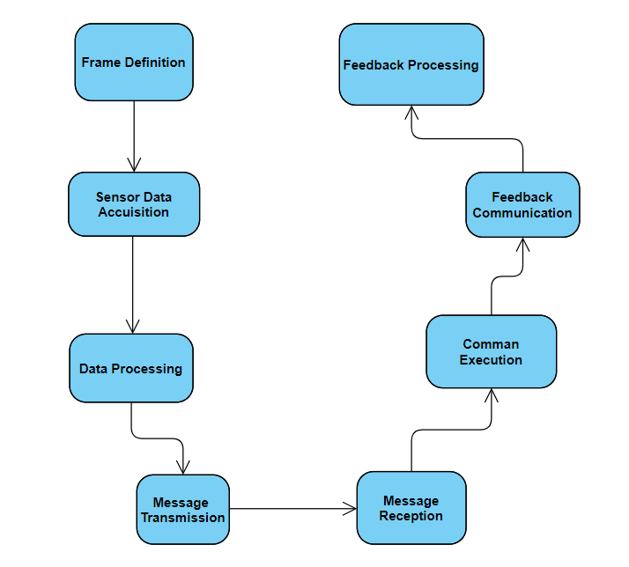
Activity Diagram

Slide 12
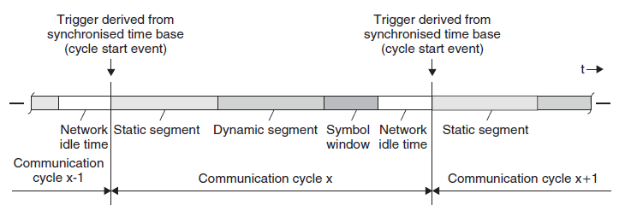
TDMA(Time Multiple Division Access)
hybrid nature in terms of media access scheme by handling both time-triggered data and event triggered data.
guarantees that only one node writes data to the Flexray bus at a time, and therefore, it guarantees the deterministic nature of Flexray as well as data collision avoidance on the bus.
Static Segment, Dynamic Segment,
Symbol Window, Network Idle Time
High-performance deterministic communication.
Less time critical and event-triggered slower message communication
Maintenance and identification of special cycles such as cold start cycle
Stays idle, while providing room to make any adjustment in network synchronisation.

Slide 13
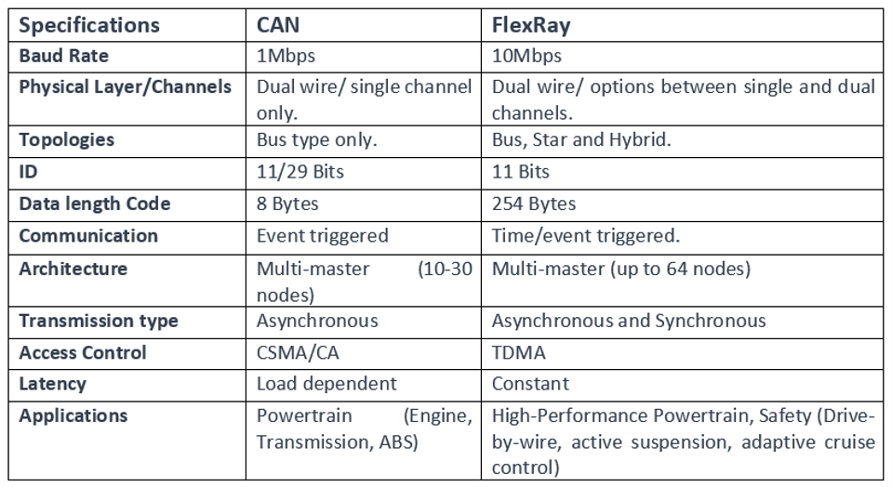
Advantages and Disadvantages
Bandwidth
(Bit arbitration x)
Hybrid Topology
Communication
Deterministic nature
Cyclic Redundancy Check
Cost

Slide 14
References
https://www.greencarcongress.com/2015/07/20150729-berger.html
https://finance.yahoo.com/news/global-automotive-electronic-control-unit-092800924.html?guccounter=1&guce_referrer=aHR0cHM6Ly93d3cuZ29vZ2xlLmNvbS8&guce_referrer_sig=AQAAADHGtu1UpWoM9qoXkc2Xcbgb6yAGv73CGEIo-MA-MP6x9k7HNyCCFK3S_xja7reh14xm0TXF2cfaMwOHDk_7N1mFEPYY05kDEAyYx4AQ9BLV0JTRX59rW6ZkcKOcb3VgDcNUShNCWxBCQxI9kyCEMfTlRtKrVCwTDtXaF2Z50x_d
https://www.eenewseurope.com/en/number-of-automotive-ecus-continues-to-rise/
https://www.precedenceresearch.com/automotive-electronic-control-unit-market
https://elearning.vector.com/mod/page/view.php?id=379
Node topology and Frame format: “Dominique Paret. FlexRay and its applications: real time multiplexed network. Wiley Online Library, 2012.”

Slide 15
Thank you for your attention !
We await your questions
(No questions will be appreciated :D)

